Slide 1
EBA3500 Lecture 2: Introduction to simple linear regression
Teacher: Jonas Moss

Slide 2
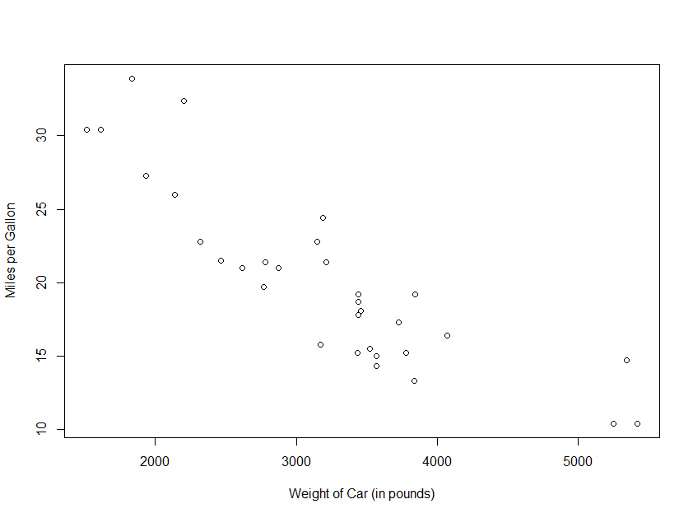
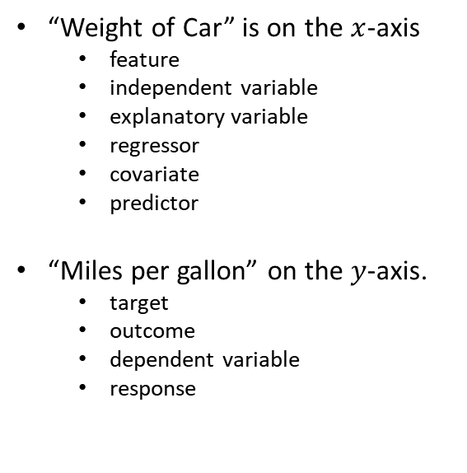
A scatterplot
“Weight of Car” is on the $x$-axis
feature
independent variable
explanatory variable
regressor
covariate
predictor
“Miles per gallon” on the $y$-axis.
target
outcome
dependent variable
response

Slide 3
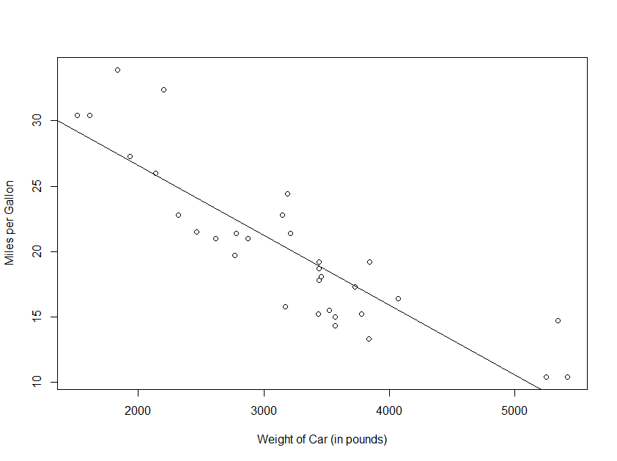
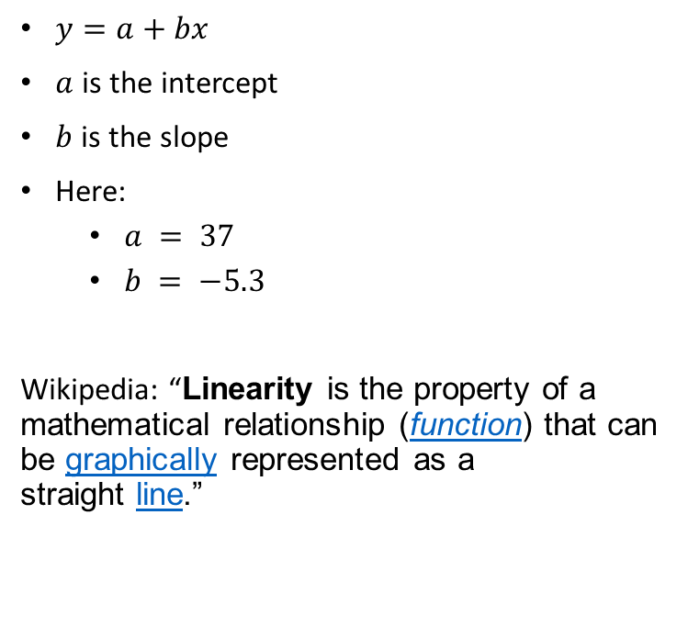
Linear regression
$y=a+bx$
$a$ is the intercept
$b$ is the slope
Here:
$a = 37$
$b = −5.3$
Wikipedia: “Linearity is the property of a mathematical relationship (function) that can be graphically represented as a straight line.”

Slide 4

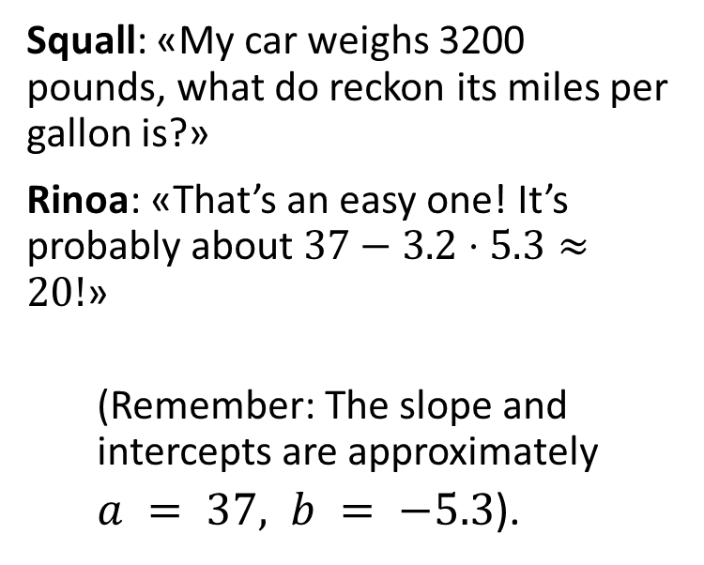
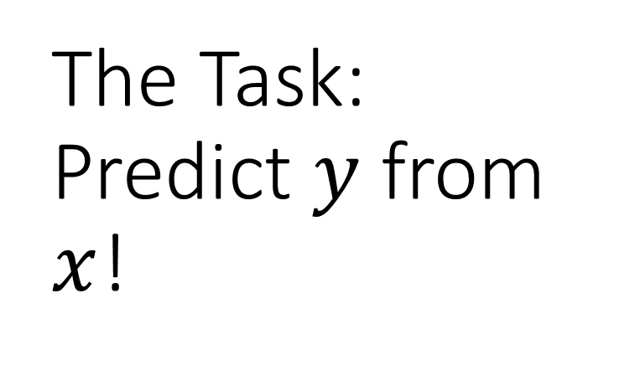
The Task: Predict $y$ from $x$!
Squall: «My car weighs 3200 pounds, what do reckon its miles per gallon is?»
Rinoa: «That’s an easy one! It’s probably about $37−3.2⋅5.3≈20!$»
(Remember: The slope and intercepts are approximately
$a = 37, b = −5.3$).

Slide 5

Other stuff too – but prediction is the most important!

Slide 6

Two prototypical curves

Slide 7
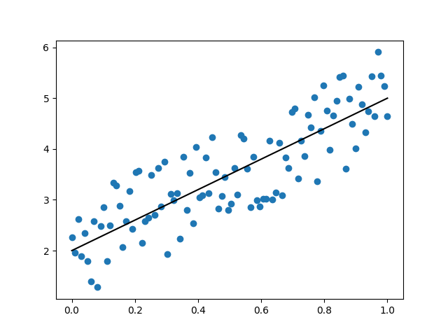
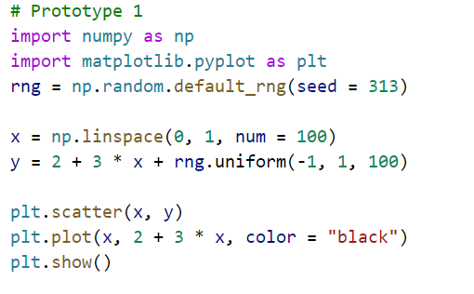

$$y=2+3x+u$$

Slide 8

You can eyeball the line! There is a true linear relationship.

Slide 9

It’s intuitively clear what the true straight line is!

Slide 10
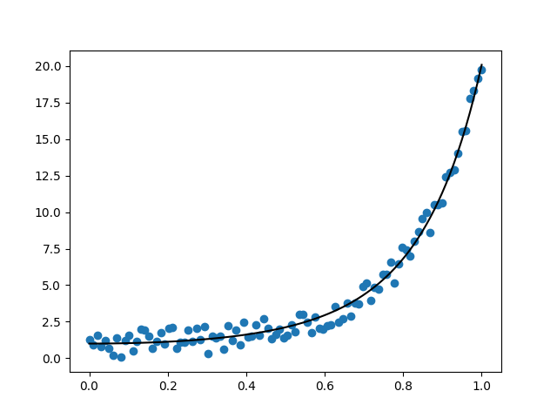
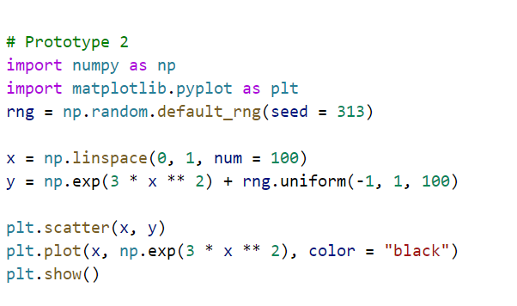

$$y=e^{3x^{2}}+u$$

Slide 11

Not so clear what the true line is! No true linear relationship.

Slide 12
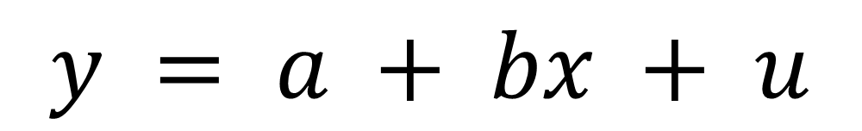
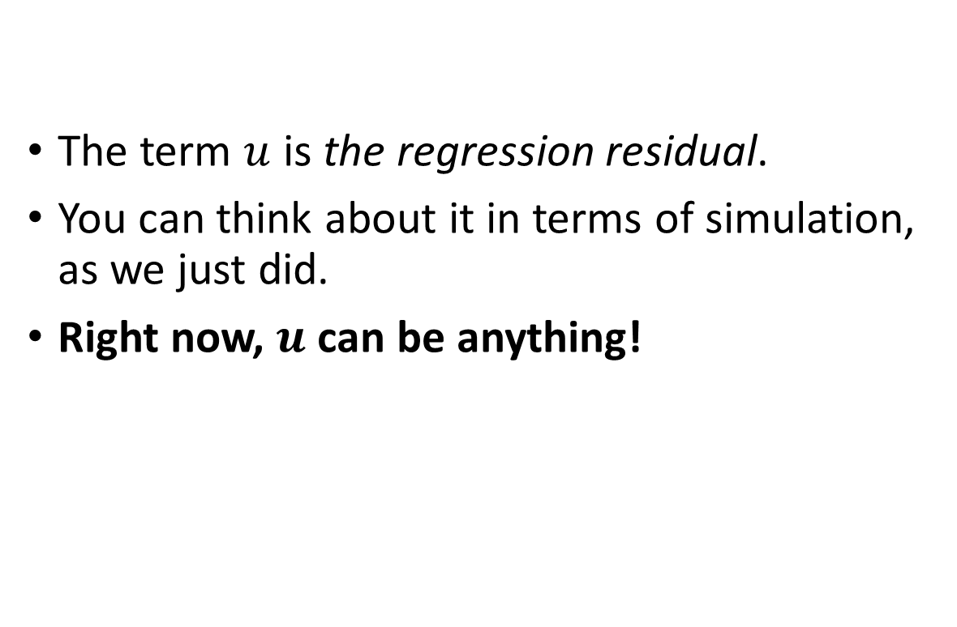
A model for the scatterplot
$$y = a + bx + u$$
The term $u$ is the regression residual.
You can think about it in terms of simulation, as we just did.
Right now, $u$ can be anything!

Slide 13
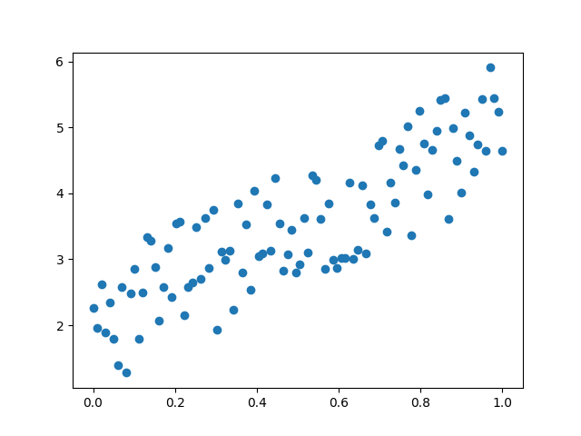
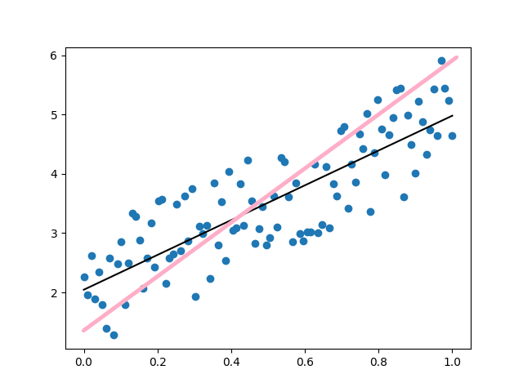
How do we get from A to B?

Slide 14

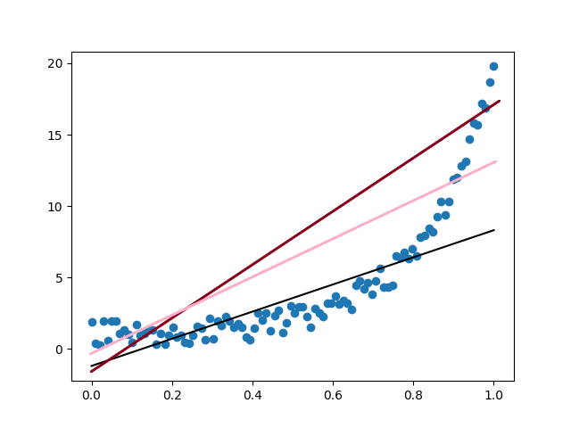
How do we get from A to «something like» B?

Slide 15

We need to define the line precisely!

Slide 16

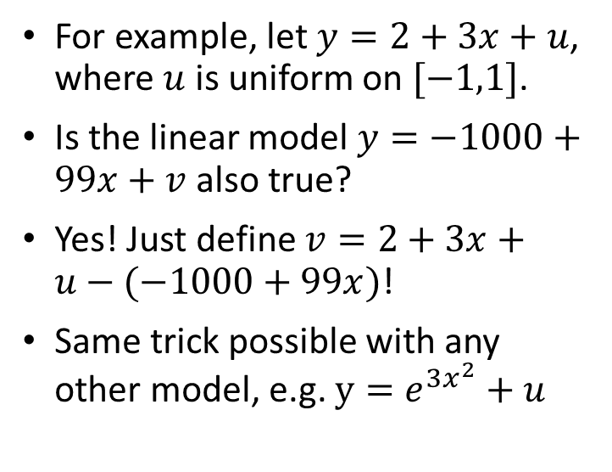
Is any line possible?
For example, let $y=2+3x+u$, where $u$ is uniform on $[−1,1]$.
Is the linear model $y=−1000+99x+v$ also true?
Yes! Just define $v=2+3x+u−(−1000+99x)$!
Same trick possible with any other model, e.g. $y=e^{3x^{2}}+u$

Slide 17

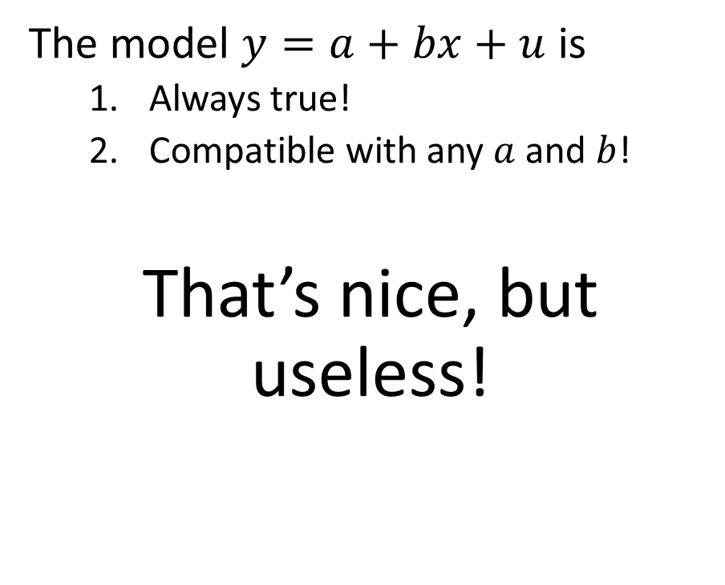

The problem $u$ have
The model $y=a+bx+u$ is
Always true!
Compatible with any $a$ and $b$!
That’s nice, but useless!

Slide 18

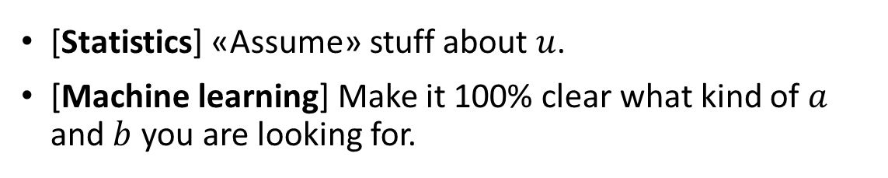
The two paths
[Statistics] «Assume» stuff about $u$.
[Machine learning] Make it 100% clear what kind of $a$ and $b$ you are looking for.

Slide 19
Goal: Find the best slope and intercept

Slide 20

Minimize the distance between the line and the data

Slide 21
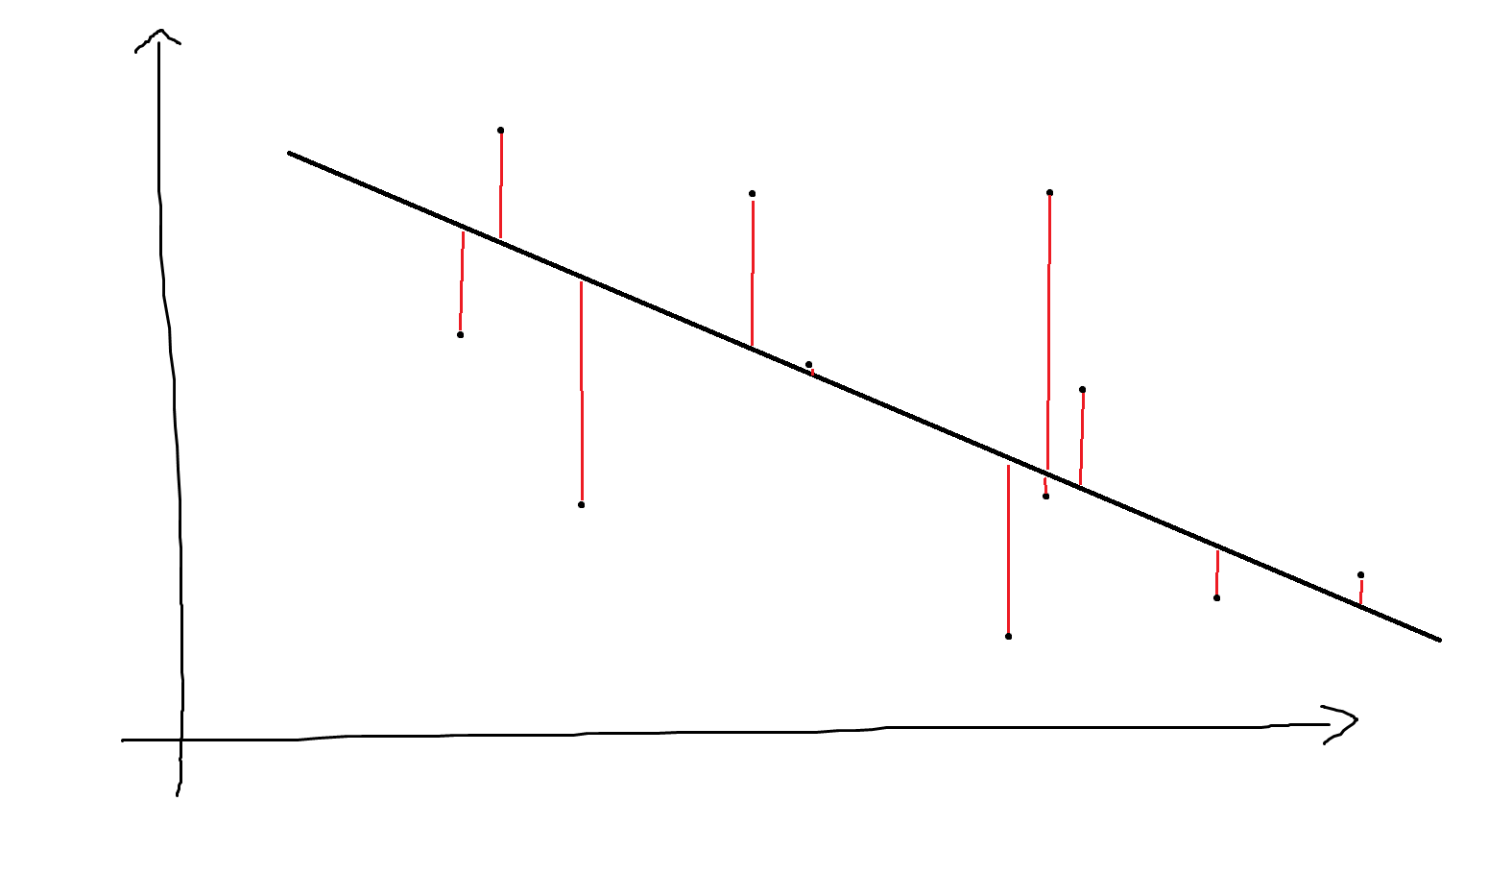
Least absolute deviations
Minimize $∑|y_{i}−\left(a+bx_{i}\right)|$ with respect to $a$ and $b$

Slide 22
statsmodels
We will mainly use statsmodels in this course. This package does a lot!
May also use scikit-learn and scipy.
statsmodels is inspired by the R ecosystem.
statsmodels is a Python module that provides classes and functions for the estimation of many different statistical models, as well as for conducting statistical tests, and statistical data exploration. An extensive list of result statistics are available for each estimator. The results are tested against existing statistical packages to ensure that they are correct. The package is released under the open source Modified BSD (3-clause) license. The online documentation is hosted at statsmodels.org.

Slide 23
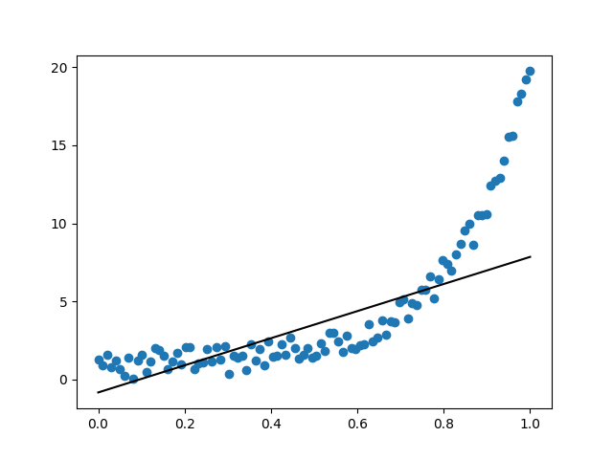
LAD with statsmodels
import numpy as np
import statsmodels.api as sm
import statsmodels.formula.api as smf
import pandas as pd
import matplotlib.pyplot as plt
mod = smf.quantreg("y ~ x", data = pd.DataFrame([y, x]).T)
res_lad = mod.fit(q = 0.5)
res_lad.params
plt.scatter(x, y)
plt.plot(x, res_lad.params[0] + x * res_lad.params[1], color = "black")
plt.show()

Slide 24


How about $y=2+3x+u$?
rng = np.random.default_rng(seed = 313)
x = np.linspace(0, 1, num = 100)
y = 2 + 3 * x + rng.uniform(-1, 1, 100)
mod = smf.quantreg("y ~ x", data = pd.DataFrame([y, x]).T)
res_lad = mod.fit(q = 0.5)
plt.scatter(x, y)
plt.plot(x, res_lad.params[0] + x * res_lad.params[1], color = "black")
plt.show()
res_lad.params
>>> res_lad.params
Intercept 2.044628
x 2.935739
dtype: float64

Slide 25

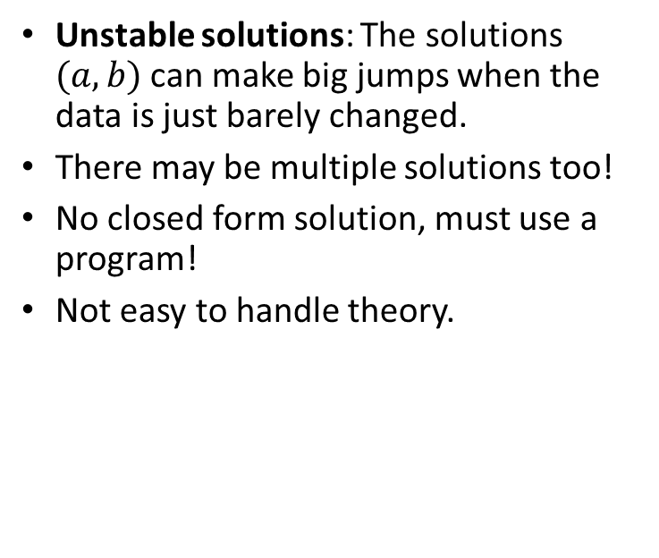
Why not least absolute deviations?
Unstable solutions: The solutions $(a,b)$ can make big jumps when the data is just barely changed.
There may be multiple solutions too!
No closed form solution, must use a program!
Not easy to handle theory.

Slide 26
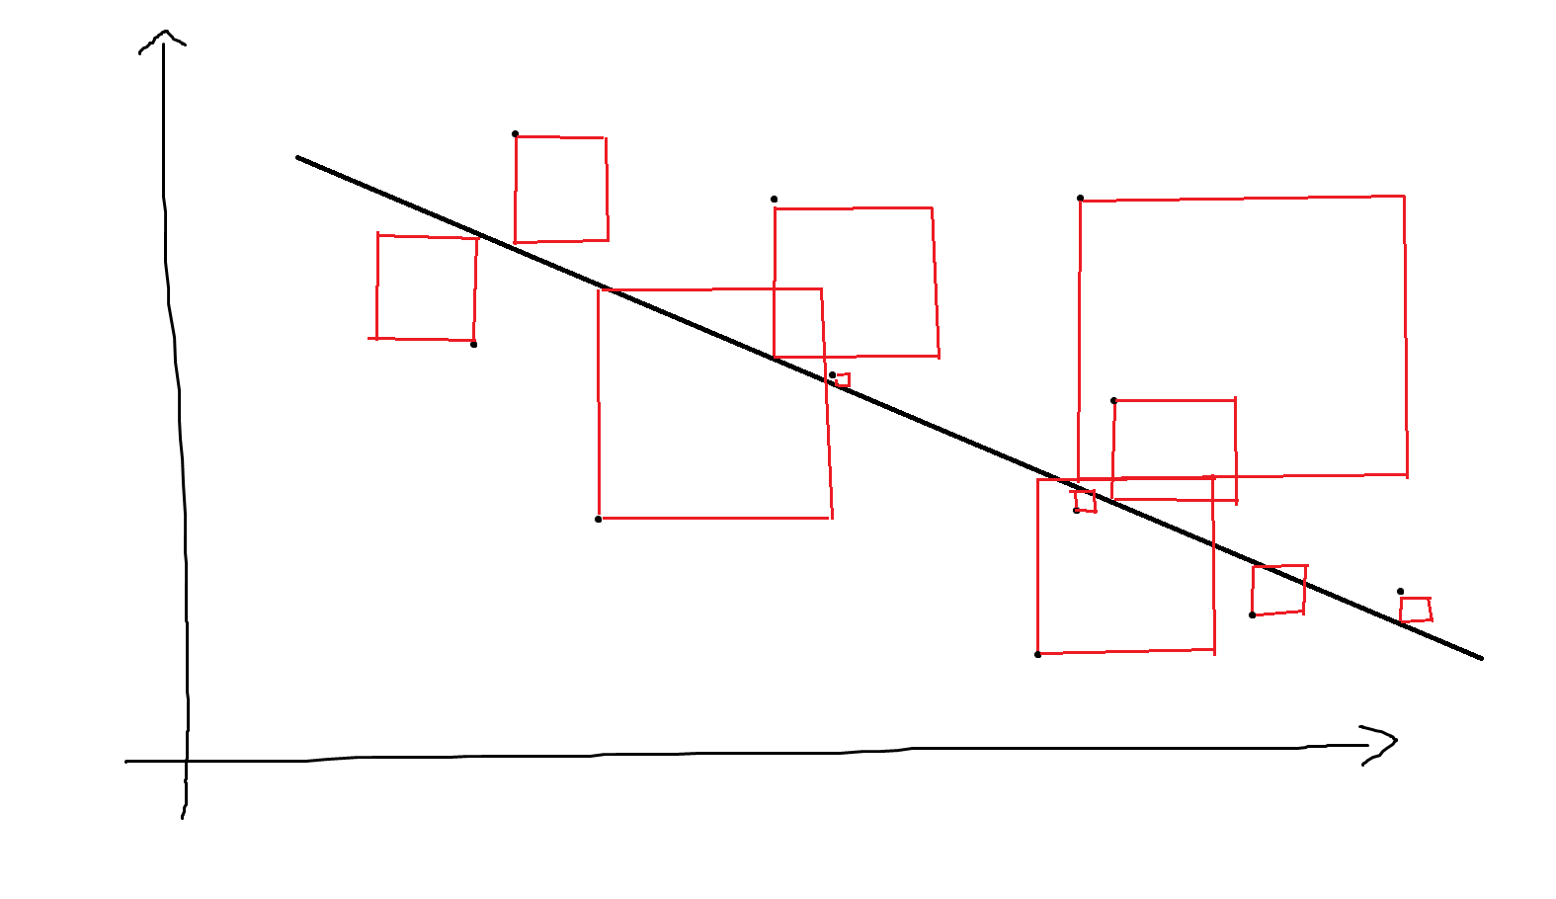
Minimizing the square
Minimize $∑{\left|y_{i}−\left(a+bx_{i}\right)\right|}^{2}$ with respect to a and b.

Slide 27
Why least squares?
Easy mathematics
Computationally simple
Some theoretical justification
Easy to generalize
A unique solution
Stable solutions

Slide 28
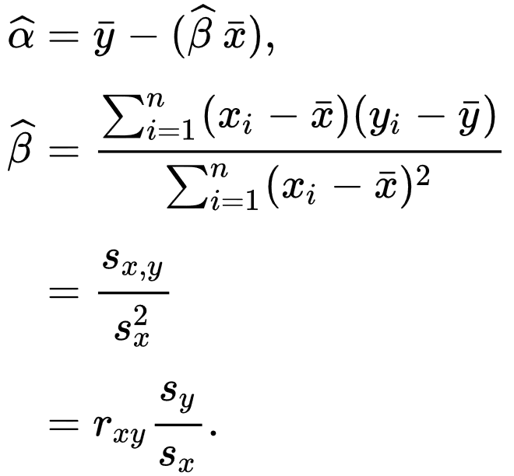
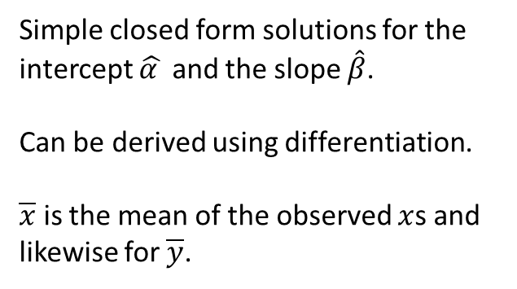
The mathematics of least squares
Simple closed form solutions for the intercept $\hat{α }$ and the slope $\hat{β}$.
Can be derived using differentiation.
$\overline{x}$ is the mean of the observed $x$s and likewise for $\overline{y}$.

Slide 29
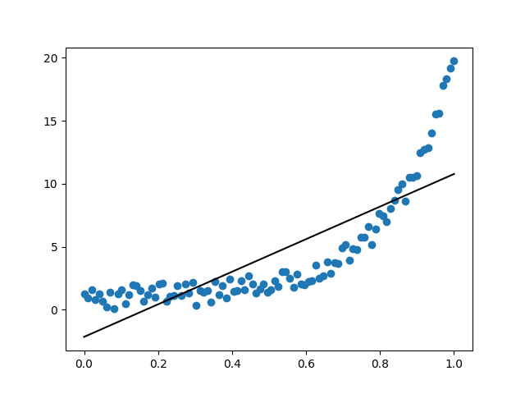
Python
import numpy as np
import statsmodels.api as sm
import statsmodels.formula.api as smf
import pandas as pd
import matplotlib.pyplot as plt
res_ls = smf.ols("y ~ x", data = pd.DataFrame([y, x]).T).fit()
res_ls.params
plt.scatter(x, y)
plt.plot(x, res_ls.params[0] + x * res_ls.params[1], color = "black")
plt.show()

Slide 30
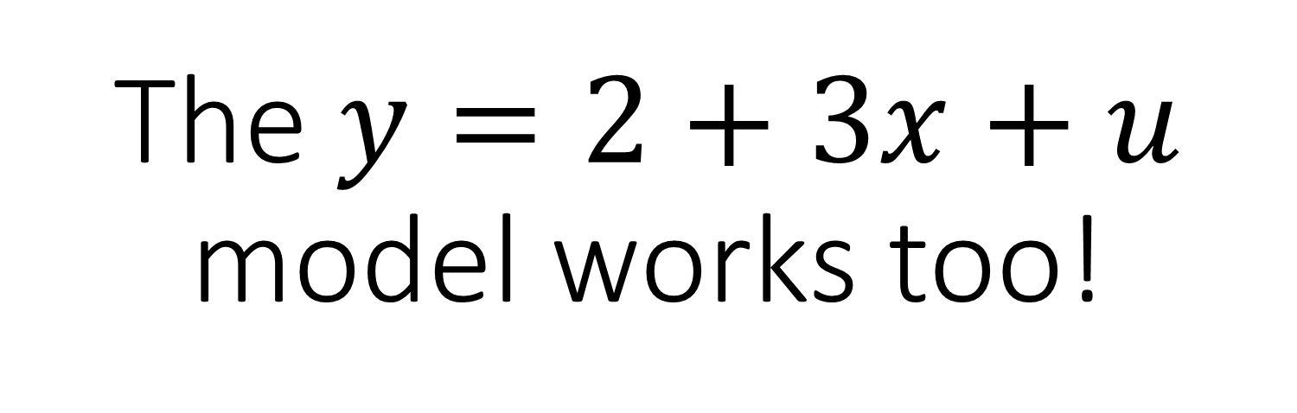
The $y=2+3x+u$ model works too!

Slide 31
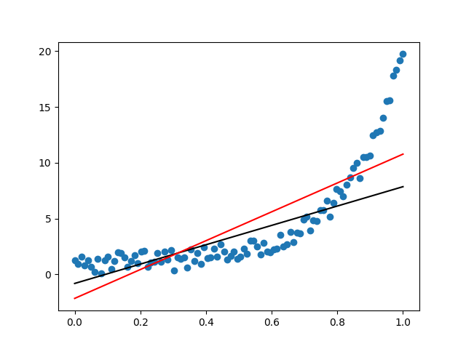
Least absolute deviations vs least squares
>>> res_ls.params
Intercept -2.160312
x 12.930593
dtype: float64
>>> res_lad.params
Intercept -0.820956
x 8.672398
dtype: float64

Slide 32
What’s «best»?
Depends on how you quantify you error. (Absolute value clearly most reasonable!)
… but also what other properties you need.

Slide 33
What kind of distances can you minimize?
Problem: $∑d(y_{i},a+bx_{i})$
Problem: ∑𝑑(𝑦_𝑖,𝑎+𝑏𝑥_𝑖)
$d$ is a distance measure, cost function, loss function.
𝑑 is a distance measure, cost function, loss function.
Reasonable properties of $d$
Reasonable properties of 𝑑
Non-negativity: $d\left(x,y\right)≥0.$
Non-negativity: 𝑑(𝑥,𝑦)≥0.
Identity of indiscernibles: $d\left(x,y\right)=0$ if and only if $x=y$.
Identity of indiscernibles: 𝑑(𝑥,𝑦)=0 if and only if 𝑥=𝑦.
Should be “smooth”.

Slide 34
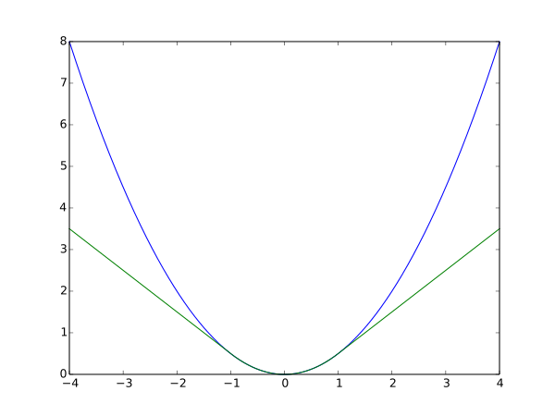
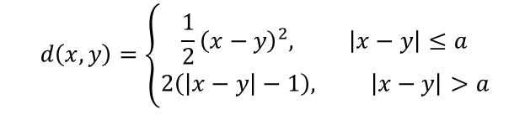
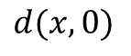
The Huber loss: Combining both losses
$$d(x,0)$$
$$d\left(x,y\right)=\left\{\begin{aligned}\frac{1}{2}{\left(x−y\right)}^{2}, \left|x−y\right|≤a \\ 2\left(\left|x−y\right|−1\right), \left|x−y\right|>a\end{aligned}\right.$$

Slide 35
rdatasets
“1300 datasets from various R packages packed as DataFrames through compressed pickle files”
https://github.com/holgern/pyRdatasets
A lot of stuff to work with here!

Slide 36

mtcars
(pip install rdatasets)
from rdatasets import data
mtcars = data("mtcars")
>>> mtcars.head()
mpg cyl disp hp drat wt qsec vs am gear carb
0 21.0 6 160.0 110 3.90 2.620 16.46 0 1 4 4
1 21.0 6 160.0 110 3.90 2.875 17.02 0 1 4 4
2 22.8 4 108.0 93 3.85 2.320 18.61 1 1 4 1
3 21.4 6 258.0 110 3.08 3.215 19.44 1 0 3 1
4 18.7 8 360.0 175 3.15 3.440 17.02 0 0 3 2

Slide 37
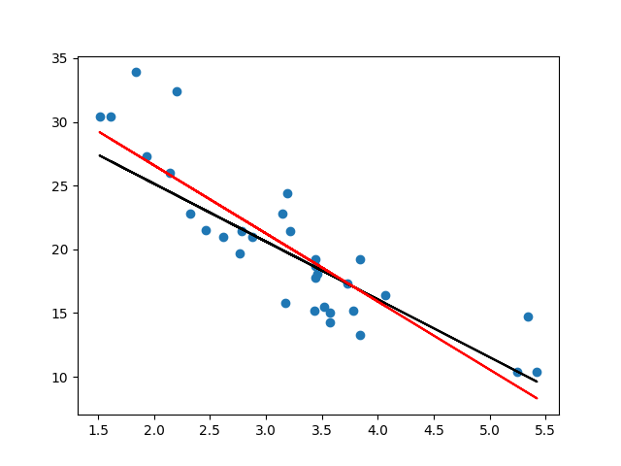
res_lad = smf.quantreg("mpg ~ wt", data = mtcars).fit(q = 0.5)
res_ls = smf.ols("mpg ~ wt", data = mtcars).fit()
plt.scatter(mtcars["wt"], mtcars["mpg"])
plt.plot(mtcars["wt"], res_lad.params[0] + mtcars["wt"] * res_lad.params[1], color = "black")
plt.plot(mtcars["wt"], res_ls.params[0] + mtcars["wt"] * res_ls.params[1], color = "red")
plt.show()
>>> res_lad.params
Intercept 34.232244
wt -4.539476
dtype: float64
>>> res_ls.params
Intercept 37.285126
wt -5.344472
dtype: float64
Not a huge difference between these fits!

Slide 38

Which would you use?

Slide 39

Summing up
Linear regression fits a linear line to a scatterplot
This line is not unique, but depends on the distance function.
The most common distance function is the squared distance.
But it does not have to be the best choice!
Doesn’t matter much if the true relationsship is linear.
The true relationsship does not have to be linear for linear regression to be used.

